Slide 1
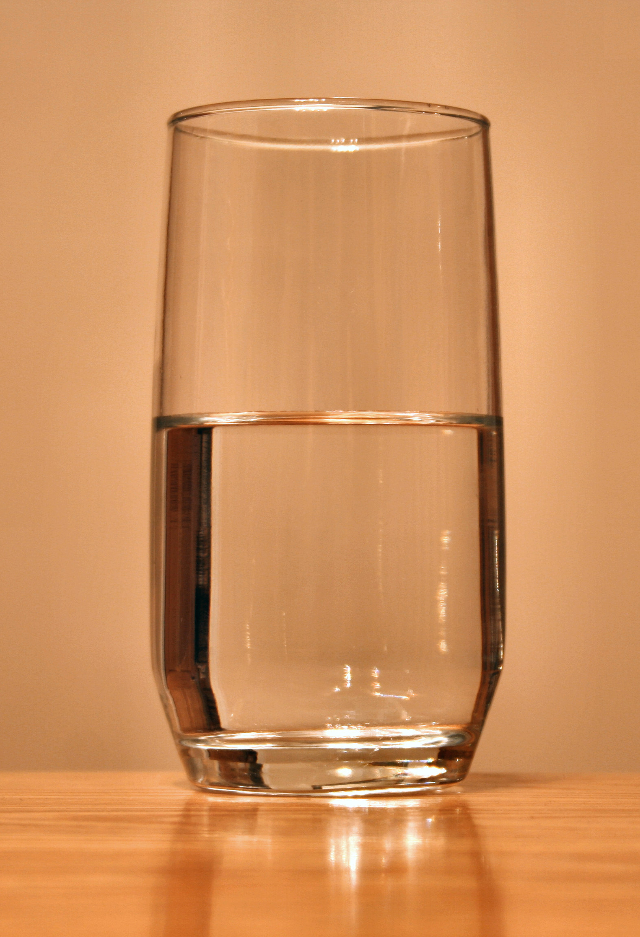
Where do you get your water?
http://commons.wikimedia.org/wiki/File:Glass-of-water.jpg

Slide 2
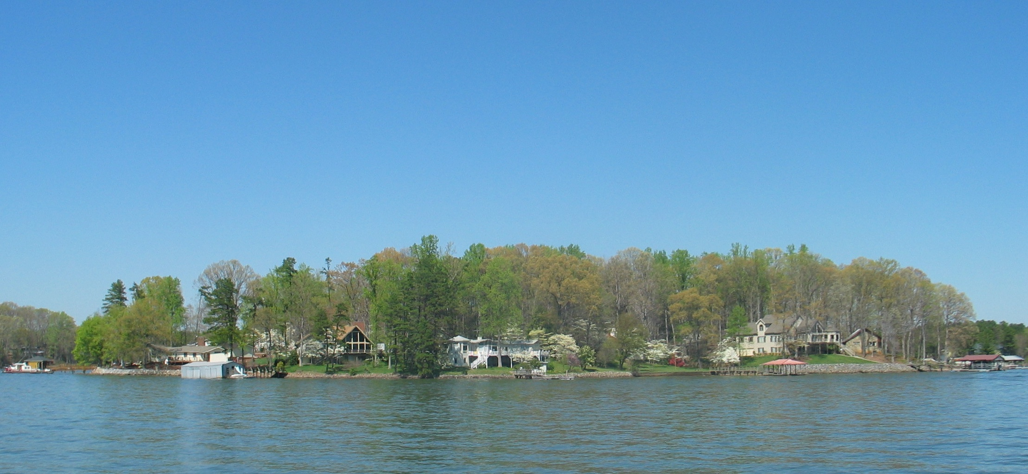
Why not from Lake Norman? (insert local lake here)
What do you think is in Lake Norman?
What might make Lake Norman unsafe to drink?
http://upload.wikimedia.org/wikipedia/commons/thumb/5/54/LakeNorman.jpg/800px-LakeNorman.jpg

Slide 3
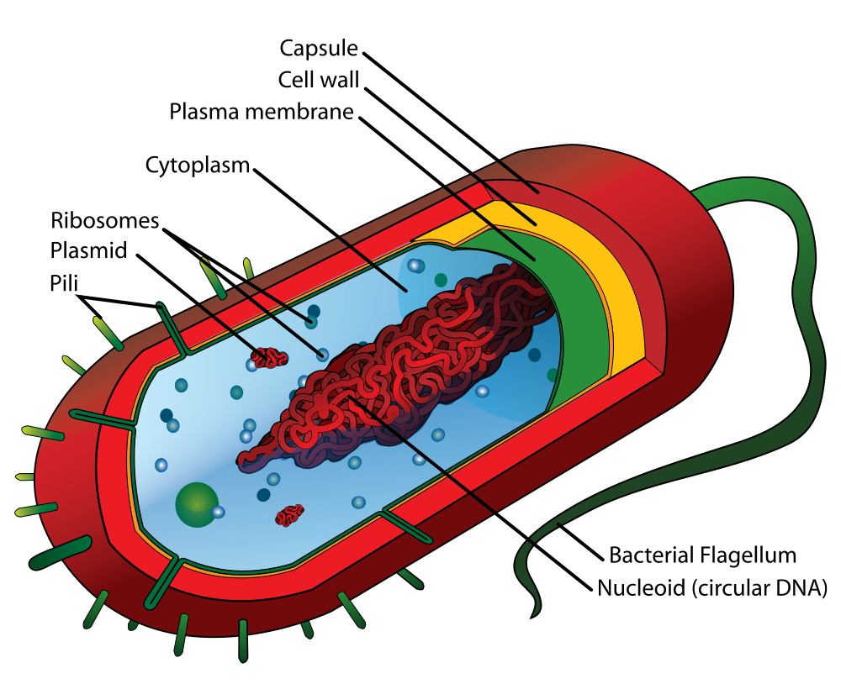
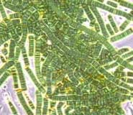
Bacteria
How are bacteria different from us?
http://upload.wikimedia.org/wikipedia/commons/f/fe/Bluegreen_algae.jpg
http://upload.wikimedia.org/wikipedia/commons/thumb/5/5a/Average_prokaryote_cell-_en.svg/1000px-Average_prokaryote_cell-_en.svg.png

Slide 4
Which one is more complex?
Prokaryote
Eukaryote
http://upload.wikimedia.org/wikipedia/commons/thumb/4/48/Animal_cell_structure_en.svg/1000px-Animal_cell_structure_en.svg.png

Slide 5
Bacteria
They’re really small!
Microorganisms
Single-celled organisms
Their cells are much less complex than ours
They don’t have organelles
For example, they don’t have a nucleus
Their DNA is arranged differently
It’s linear like our chromosomes – it’s usually all held in just one circle

Slide 6
Why are bacteria in our lakes?

Slide 7
Bacteria are essential to a healthy ecosystem
The bacteria in lake decompose the dead organic material that sinks to the bottom
Without them, dead matter would stay on the bottom forever, and the food web wouldn’t be complete!

Slide 8
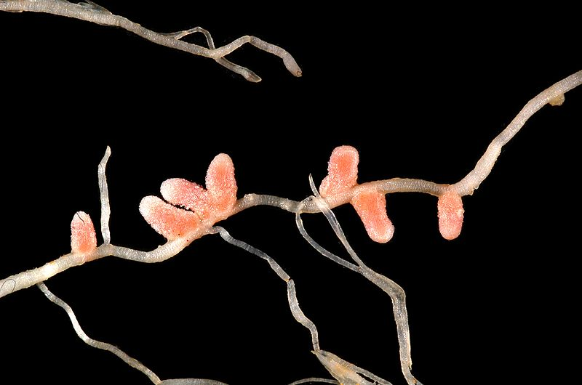
Most bacteria are good
Just like in our lakes, bacteria decompose things in our bodies
They digest our food
Some bacteria have special tools
Nitrogen fixing bacteria
Mutualistic symbiosis
http://commons.wikimedia.org/wiki/File:Medicago_italica_root_nodules_2.JPG

Slide 9
Some bacteria can harm us
These strains have an extra “tool,” and can produce a toxin which harms us
Some strains of E. coli (but only some strains) cause food poisoning
Diseases caused by harmful bacteria living in water:
Cholera
Dysentery
These diseases are no longer common in the US, but they are still rampant in many countries without clean drinking water.

Slide 10
How could we detect bacteria in water?

Slide 11
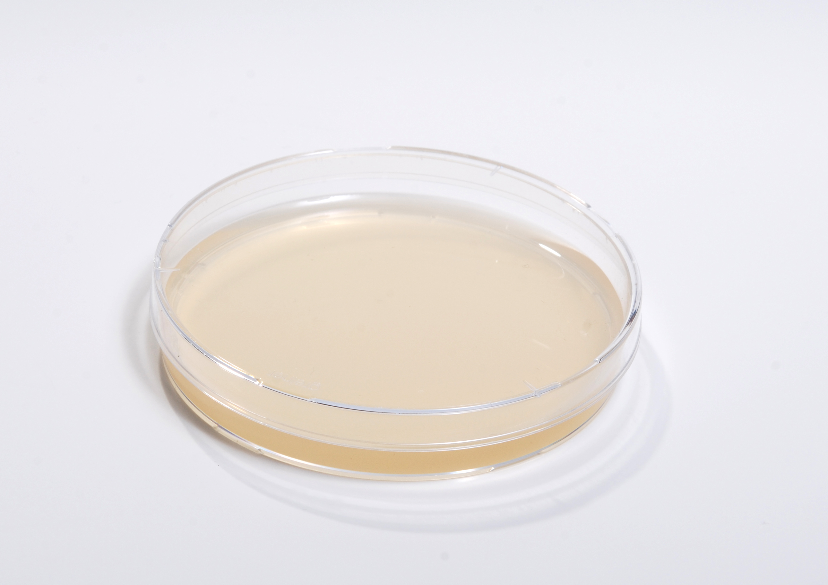
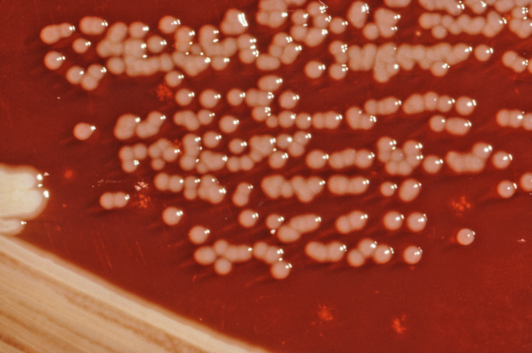
Plating Bacteria
When we put bacteria onto plates, like the one shown below on the left, they grow into colonies we can see with our own eyes, like the ones shown below on the right
http://commons.wikimedia.org/wiki/File:YPED_agar_plate.jpg
http://commons.wikimedia.org/wiki/File:Yersinia_enterocolitica_01.png

Slide 12
Selective Media
Different types of bacteria require different types of food
If you want to see if your sample contains a particular type of bacteria you can use media that only has certain types of food– the foods that that bacteria can use but that other types of bacteria can’t.
This media “selects” for bacteria that can grow on the types of food it provides

Slide 13
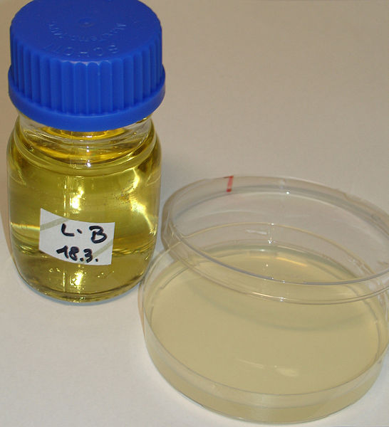
Examples of media types: LB
LB (Luria broth) media is nutritionally rich
Most bacteria can grow on this – it doesn’t “select” for any particular type
Standard bacterial media used in labs around the world when they want as many different types of bacteria to grow as possible
http://commons.wikimedia.org/wiki/File:LBmedium.JPG

Slide 14
EMB (Eosin Methylene Blue) Media
Can detect “gram negative bacteria”
E-coli and other bacteria found in our digestive system are gram negative
This type of media can help detect septic spills in waterways (yes, fecal matter in waterways)
Most of the bacteria in our gut is harmless
Some fecal bacteria can be harmful to ingest
While the bacteria that grows on EMB isn’t harmful itself, higher-than-normal levels of these bacteria can are used to indicate and increased potential that harmful bacteria may be there also.

Slide 15
Citrate Media
Only contains one type of sugar and source of carbon: citrate
This media is very selective. Only organisms specialized to survive off of citrate can grow.
pH indicator dye indicates growth – plate is green and turns blue when bacteria are able to grow on it.
http://commons.wikimedia.org/wiki/File:Simmons%27_citrate_agar.jpg

Slide 16
So if some bacteria are harmful and there are bacteria in water supplies like lakes… how can we remove bacteria from water and make it safe to drink?

Slide 17
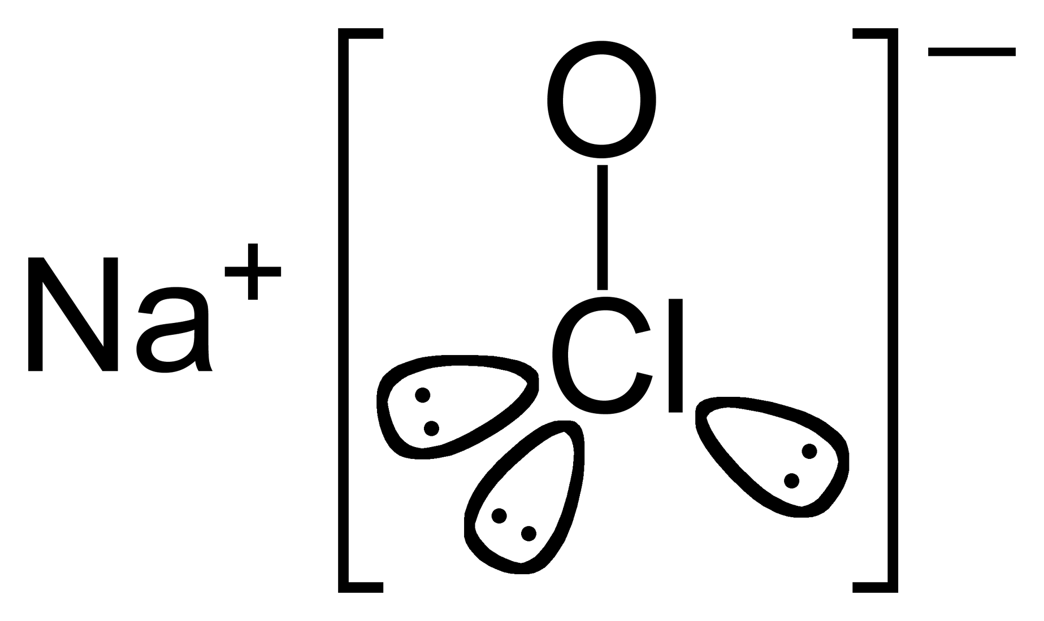
One way to disinfect: Bleach
Sodium Hypochlorite
http://en.wikipedia.org/wiki/File:Sodium-hypochlorite.png

Slide 18
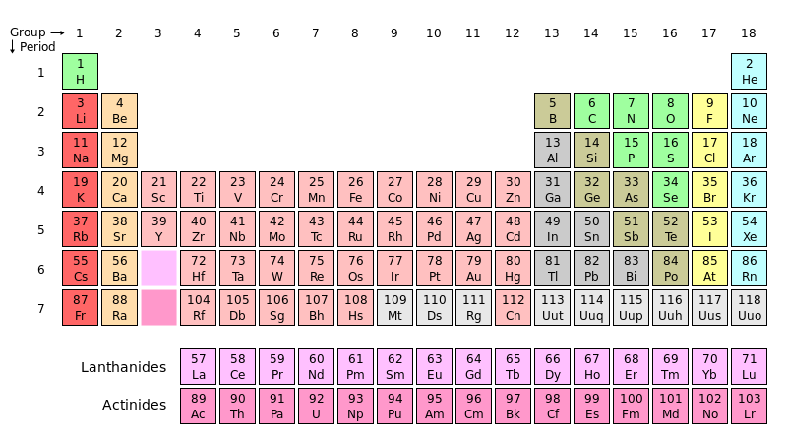
Where is chlorine (Cl) on the periodic table?
What does that tell us about its properties?
http://en.wikipedia.org/wiki/File:Periodic_table.svg

Slide 19
Bleach: an oxidizing agent
Chlorine needs one more electron to fill its valence shell, so it steals electrons
This process is known as oxidation
Strong oxidizing agents (like bleach) are so reactive that they can disrupt cell function
Why can bleach kill bacteria so easily?
Bacteria are single cellular organisms and can’t recover from the damage bleach does
Bleach isn’t good for us either

Slide 20
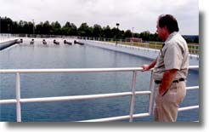
How is our water actually treated? (example from Davidson, NC )
At the Lee S Dukes Water Treatment Plants, located in Huntersville
Their website explains exactly how the treatment process works →
http://charmeck.org/city/charlotte/Utilities/Divisions/PublishingImages/cmu71.jpg

Slide 21
Step 1: Coagulation
Liquid aluminum sulfate (alum) is added to untreated water
This makes tiny particles of dirt in the water coagulate (stick together)

Slide 22
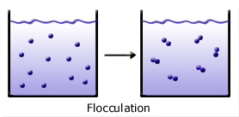
Step 2: Flocculation
Paddles stir the alum and water, causing them to stick together and form large, heavier particles called floc
http://water.me.vccs.edu/courses/env108/changes/flocculation.jpg

Slide 23
Step 3: Sedimentation
After flocculation, water moves into a sedimentation basic where the water flows slowly
Heavy floc particles sink and settle at the bottom
Floc which collects on the bottom of the basin is removed from the water

Slide 24
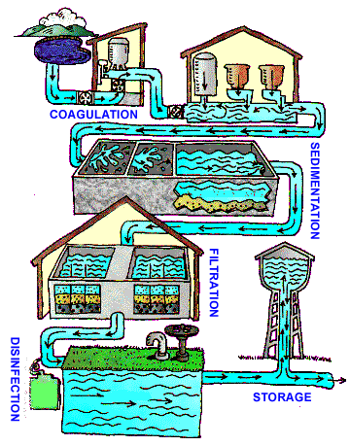
Step 4: Filtration
All the large particles have been removed, but just to make sure all the little grains are gone, the water moves through a fine filter made of sand and gravel
http://www.epa.gov/ogwdw/kids/watertreatmentplant/images/image_watertreatmentcycle.gif

Slide 25
Step 5: Disinfection
As we just learned, chlorine bleach can get rid of bacteria
Our water treatment facility uses gaseous chlorine to disinfect the water

Slide 26
Now that we’ve learned about the system, let’s see it for ourselves!

